Slide 1

2020 Election Sentiment Analysis and State Results Prediction
Presented by: Alex Hamedaninia
Notes:
Welcome to the presentation on the 2020 election sentiment analysis and state results prediction. My name is Alex Hamedaninia, the creator of this project and I will be leading you through a discussion on what this project entails.

Slide 2
Overview
Research Question
Background
Data Preprocessing
Exploratory Data Analysis
Analysis
Results
Ethics/Limitations/Assumptions
Conclusion
References
Notes:
Today we will be discussing our research question, going into some background of why we chose it, how we preprocessed and cleaned the data, what we learned in our exploratory data analysis, our analysis and results, and what ethics, limitations, and assumptions we have to consider before reaching our conclusion.

Slide 3

Research Question
Can we predict the results of the 2020 election based on public sentiment analysis on social media platforms?

Slide 4
Background
Presidential elections are characterized by intense, diverse viewpoints
Understanding public sentiment about either presidential candidate is crucial for the campaigning parties, especially at the state-based level
This project aims to conduct sentiment analysis using natural language processing
Twitter played an especially important role in the 2020 election
Notes:
Presidential elections in the United States are characterized by intense competition and diverse viewpoints, shaping the nation's future.
Understanding public sentiment towards candidates is crucial, including whether it leans positive or negative and state-specific sentiments.
This project aims to conduct sentiment analysis using natural language processing on Twitter data from the 2020 election year to explore public opinion.
Social media platforms, particularly Twitter, play a significant role in facilitating global communication and offer valuable insights into public opinion, societal trends, and human behavior.
Twitter's dynamic nature allows users to express opinions, share news, and engage in discussions, making it a rich source of real-time data for researchers, analysts, and policymakers.

Slide 5
Data Preprocessing
To keep anonymity of Twitter users, user-related information was removed.
Removed any tweets not from within the United States
Removed any tweets where user location was not available.
Cleaned the tweets by removing unnecessary strings and characters
‘@user’ and any ”#”
Notes:
To keep anonymity of Twitter users, user-related information was removed. This includes username, user screen name, user description and user join date. Then, since this study is state-based, I Removed any tweets not from within the United States. I followed this up with then removing any tweets that a user location was not reported, as this would not be useful to our study, and would reduce future computation time. Lastly, I cleaned the tweets by removing any strings that were mentioning another user with the use of the @ symbol, and removed the leading hashtag.

Slide 6
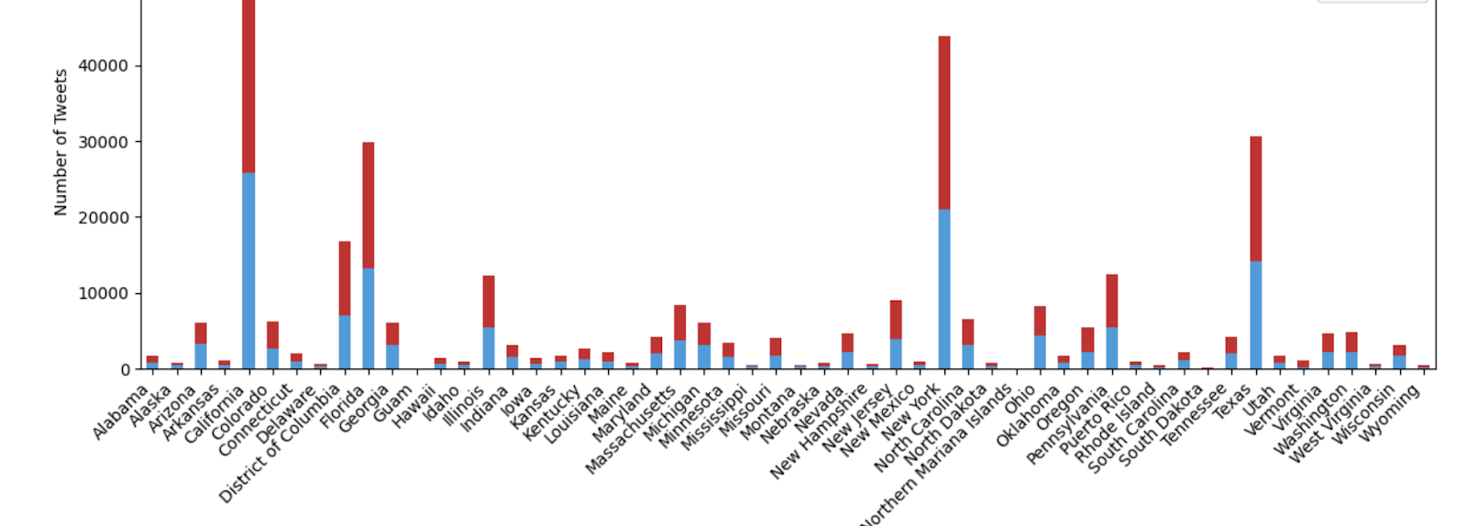
Exploratory Data Analysis
Notes:
We can see there is a very disproportionate amount of tweets coming from the bigger states, due to most likely a higher population. More specifically, these bigger states have a higher city and urban population as opposed to the more rural states. It is important to keep this in mind when conducting further analysis, as a higher tweet amount represents a larger sample size of that state’s population, whereas a lower tweet amount represents a smaller sample size, leading to results that may not fully represent that population.
we can also see that for almost every state, the amount of discussion surrounding each candidate in each state is nearly equal. While this does not indicate whether the discussion was positive or negative, it does give a clear indicator that for each state, the conversation surrounding both candidates is quite equal.

Slide 7
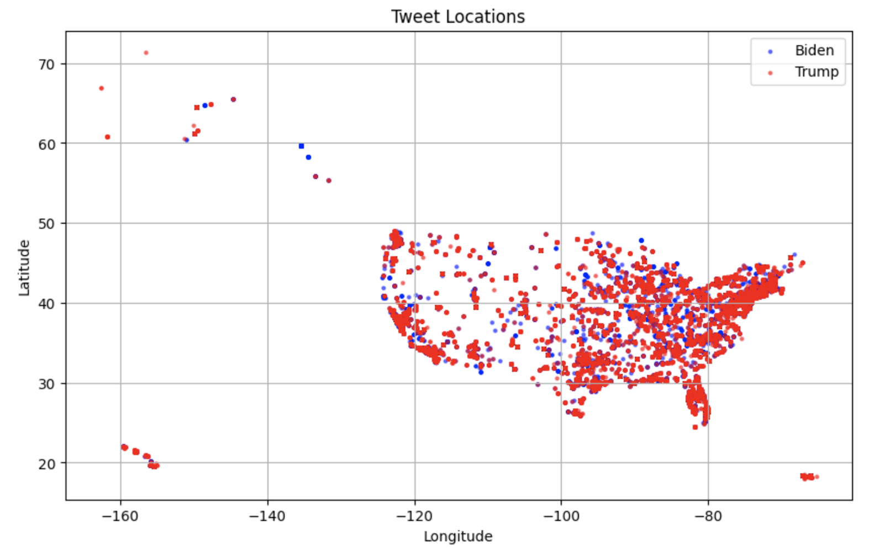
Exploratory Data Analysis (cont’d)
Notes:
we can take a look at where the tweets originated from on a map, and see where they are speaking about Biden and Trump. There is quite the spread of discussion regarding Trump, and it may be overlapping the points showing the discussion regarding Biden. But we can see that they are quite equal when it comes to being discussed around the US, though there is a significant amount missing from the Midwestern part of the United States. This could potentially affect the analysis later by incorporating an unintentional bias that will be important to keep in mind.

Slide 8

Sentiment Analysis
Utilize sentiment analyzer tool TextBlob to determine tweet sentiment
Subset the data to be grouped by state and candidate by the polarity for each candidate
Determine which candidate had a higher sentiment and determine them the winner of that state
Notes:
In this section, we are ready to conduct our sentiment analysis of the tweets. I iterate through each tweet, analyzing the sentiment polarity of it, and adding this polarity to the end of the dataframe. Following this, I create a subset of the data, grouping the data by state, candidates, and the polarity for each of those candidates. The candidate with the higher polarity value is chosen, and we finish with a dataframe of all the states and their chosen candidates.

Slide 9
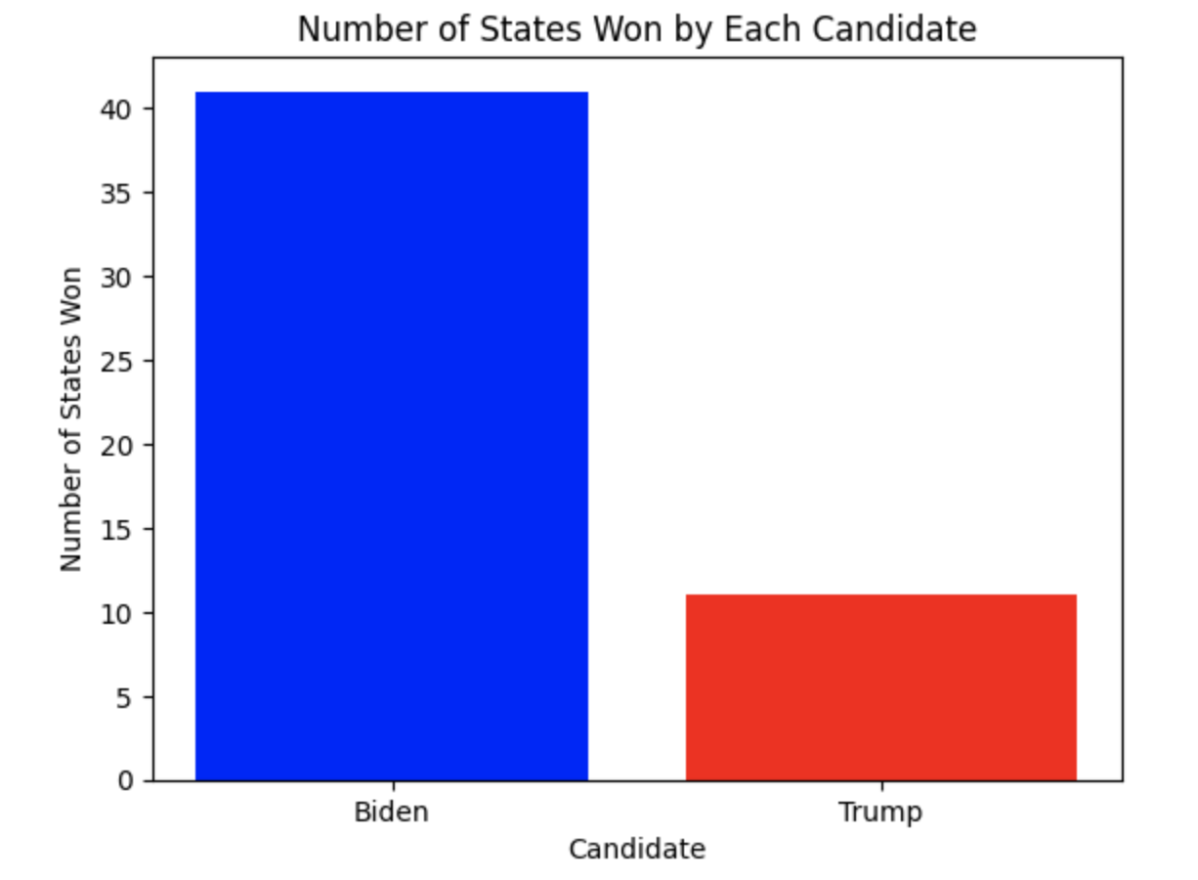
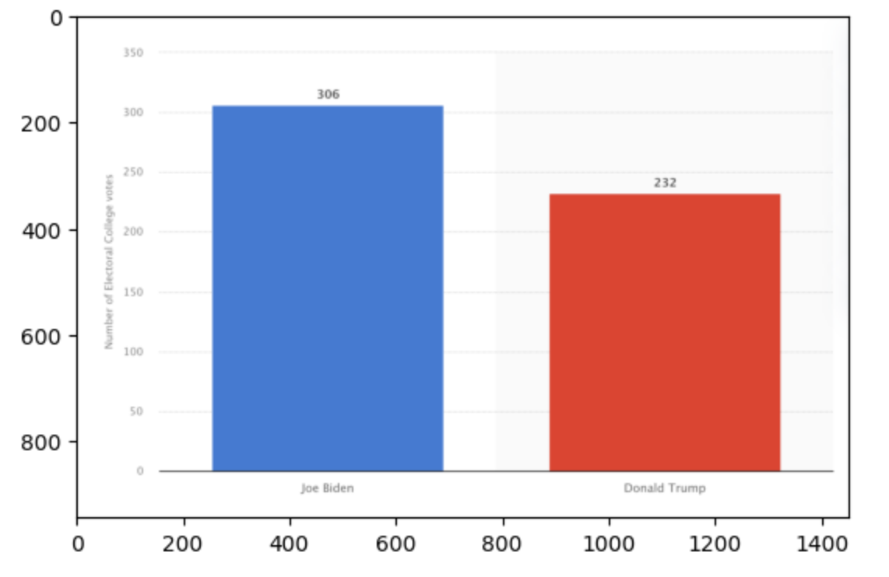
Results
Notes:
When we plot this into a bar graph, we see the clear winner is Joe Biden, displayed on the left. On the right, we have a comparison of the actual results from the electoral college votes in the 2020 election. As we know, Joe Biden won that year, and we can see the margin was a bit closer than predicted. This is most likely due to the lack of representation of the Midwestern states that are traditionally more inclined to vote Republican rather than Democratic. However, the results are quite close, and with further modification, they may be able to get even closer.

Slide 10
Ethics, Limitations, and Assumptions
Not all Twitter users are voters, and not all voters are on Twitter
Due to limited location availability from Twitter users, many tweets had to be removed
The results will not be used to manipulate public opinion, influence political outcomes, or engage in unethical practices.
Notes:
While using a social media platform to conduct sentiment analysis to gain an understanding of public sentiment about a candidate can be a good starting point, it is important to remember that Twitter users are not wholly representative of the state. On the contrary, not all users on Twitter may vote, and not all voters are on Twitter. There is also the issue that not all users that Tweeted made their locations available, and much of the data had to be removed due to this. It is seemingly random which part of the population made their location unknown. to incorporate a more well rounded analysis of the country’s stance on political candidates, the use of other social media platforms may prove to make up for this difference. Social media platforms are highly susceptible to the spread of misinformation, and I will exercise caution when distinguishing between genuine sentiment and false or misleading information. Lastly, it is important to use the findings of this study responsibly and ethically, and the results will not be used to manipulate public opinion, influence political outcomes, or engage in unethical practices.

Slide 11
Conclusion
While the results were not entirely accurate, they serve as a good starting point in determine public sentiment regarding presidential candidates.
Further recommendations: utilizing a a stronger sentiment analyzer tool like Transformer tool roBERTa, and utilizing other social media platforms that may be more relevant today, like Facebook or TikTok
Notes:
we have now reached the conclusion of this project. while the results were not perfectly accurate, they serve as a great starting point for determining public sentiment regarding the presidential candidates using social media platforms.
further recommendations to make this project stronger is with the use of a stronger sentiment analyzer tool like the transformer tool roberta, which is a powerful sentiment analyzer tool that has been specifically trained on over 52 million tweets to determine their sentiment. the only reason we didn't use it here is it is very resource-intensive and computationally expensive, and time simply didn't allow for that. also, to reduce the potential bias that was introduced with the lack of representation of the smaller states, i recommend utilizing other social media platforms as well, such as facebook or tiktok, to gain a more well rounded public sentiment.

Slide 12
References
Manch Hui. 2020, November). US Election 2020 Tweets, Version 3. Retrieved March 31, 2024 from https://www.kaggle.com/datasets/manchunhui/us-election-2020-tweets.
Published by Statista Research Department. (2024, February 22). 2020 presidential election: Results U.S. 2020. Statista. https://www.statista.com/statistics/1184537/2020-presidential-election-results-us/
Notes:
and that concludes our presentation today. thank you for watching and we will begin the Q&A after this.

Slide 13
Q&A
What are the primary objectives of the study?
How was the data collected and processed from the Biden and Trump datasets?
What methods were employed to extract state information from user locations in the datasets?
How were missing or incomplete data handled during the analysis?
What specific metrics or criteria were used to determine the candidate affiliation of each tweet?
Notes:
What are the primary objectives of the study?
To gain an understanding into the 2020 election and attempt to predict the winner of the election based on the public sentiment via Twitter discussions.
How was the data collected and processed from the Biden and Trump datasets?
The dataset was obtained from a Kaggle dataset. The creator of the dataset stated that they obtained the Tweets from the Twitter API using the statuses_lookup and snsscrape for keywords. The tweets range from the beginning of 2020 up to 11/8/2020.
What methods were employed to extract state information from user locations in the datasets?
If the user allowed it, the user’s location was part of the data extracted from the Twitter API. From here, I only included the tweets where the user’s location was present, excluding any unknown locations.
How were missing or incomplete data handled during the analysis?
As this study was location based, I dropped any missing user location. I also excluded any tweets that did not originate from within the United States, as this study is solely focused on those in the United States.
What specific metrics or criteria were used to determine the candidate affiliation of each tweet?
The candidate affiliation was predetermined by the Kaggle dataset creator. Their method was to distribute them into either the Biden or Trump dataset by whoever’s name was stated in the tweet, no matter the polarity or sentiment of the tweet.

Slide 14
Q&A
How were the total numbers of tweets per state calculated for both Biden and Trump?
Were any statistical tests conducted to compare the distribution of tweets per state between Biden and Trump?
What are the implications of the findings for understanding public sentiment and engagement on social media during the election period?
How might the results of the study contribute to our understanding of the political landscape and dynamics across different states?
What potential limitations or biases should be considered when interpreting the results, and how might they impact the validity and generalizability of the findings?
Notes:
How were the total numbers of tweets per state calculated for both Biden and Trump?
By creating a stacked bar graph that showed the distributions of tweets for both Biden and Trump. The specific calculations of the tweets were not done, but more so a visualization to confirm that the distribution of the tweets for the two candidates was equal.
Were any statistical tests conducted to compare the distribution of tweets per state between Biden and Trump?
No statistical tests were conducted to compare the distribution, but a visualization of the distribution of tweets per state was done to show this distribution. It showed that there was a largely disproportionate amount of tweets coming from the large three states, California, New York, and Texas, most likely due to the larger population.
What are the implications of the findings for understanding public sentiment and engagement on social media during the election period?
During the election period, tensions were higher and it was hard to gain an understanding of where the public stood in regards to one presidential candidate or the other. The implications of understanding public sentiment and engagement on social media would allow us to gain an understanding of where each state stands in regards to the candidates. It provides insight, and with further analysis, could provide the candidates with ideas on how to improve their campaigning techniques to have a stronger reach on the voters.
How might the results of the study contribute to our understanding of the political landscape and dynamics across different states?
The results will allow us to understand how the voters in each state feel in regards to a presidential candidate. This is especially important for swing states, where they may vote for either party. These states are incredibly important to presidential candidates, as gaining the favor of these states will swing the vote in their direction.
What potential limitations or biases should be considered when interpreting the results, and how might they impact the validity and generalizability of the findings?
It is important to keep in mind that there was a disproportionate amount of tweets coming from the three major states: California, New York, and Texas. There were big gaps in the Midwestern part of the United States, as demonstrated in one of the graphs. This implies that the results of the sentiment analysis for those particular states is not wholly representative of the population. It is also important to remember that those who are active on Twitter are not always the ones who vote, and the ones who vote are not always active on Twitter.

